Slide 1
Programming With C++/R
DST102TC
Huakang Li
Huakang.li@xjtlu.edu.cn
School of AI and Advanced Computing
Notes:
English Title: Uppercase, Calibri size 60, XJTLU Navy
English Subtitle: Uppercase, Calibri size 36, XJTLU Navy

Slide 2
Chapter 16
Exception Handling
Notes:
English Title: Uppercase, Calibri size 60, XJTLU Navy
English Subtitle: Uppercase, Calibri size 36, XJTLU Navy

Slide 3
Objectives
To get an overview of exceptions and exception handling (§16.2).
To know how to throw an exception and how to catch it (§16.2).
To explore the advantages of using exception handling (§16.3).
To create exceptions using C++ standard exception classes (§16.4).
To define custom exception classes (§16.5).
To catch multiple exceptions (§16.6).
To explain how an exception is propagated (§16.7).
To rethrow exceptions in a catch block (§16.8).
To define functions with an exception throw list (§16.9).
To use exception handling appropriately (§16.10).

Slide 4
Exception-Handling Overview
To demonstrate exception-handling, let us begin with an example in Listing 16.1 that reads in two integers and displays their quotient.

Slide 5
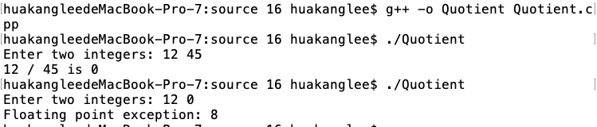
Quotient.cpp
#include <iostream>
using namespace std;
int main()
{
// Read two intergers
cout << "Enter two integers: ";
int number1, number2;
cin >> number1 >> number2;
cout << number1 << " / " << number2 << " is "
<< (number1 / number2) << endl;
return 0;
}

Slide 6
Exception-Handling Overview
If you enter 0 for the second number, a runtime error would occur, because you cannot divide an integer by 0.
A simple way to fix the error is to add an if statement to test the second number as shown in Listing 16.2.

Slide 7
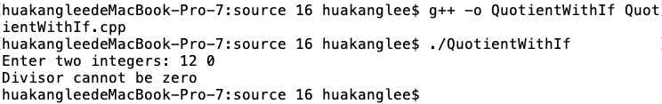
QuotientWithIf.cpp
#include <iostream>
using namespace std;
int main()
{
// Read two integers
cout << "Enter two integers: ";
int number1, number2;
cin >> number1 >> number2;
if (number2 != 0)
{
cout << number1 << " / " << number2 << " is "
<< (number1 / number2) << endl;
}
else
{
cout << "Divisor cannot be zero" << endl;
}
return 0;
}

Slide 8
Exception-Handling Overview
Listing 16.2 can be rewritten using exception handling as shown in Listing 16.3. Listing 16.2 is simpler than Listing 16.3. You should not use exception handling in this case.
However, the purpose of Listing 16.3 is to give a simple example to demonstrate the concept of exception handling.
Later you will see the advantages of using exception handling.

Slide 9
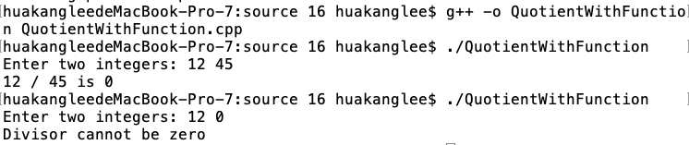
QuotientWithFunction.cpp
#include <iostream>
using namespace std;
int quotient(int number1, int number2)
{
if (number2 == 0)
{
cout << "Divisor cannot be zero" << endl;
exit(0); // Terminate the program
}
return number1 / number2;
}
int main()
{
// Read two integers
cout << "Enter two integers: ";
int number1, number2;
cin >> number1 >> number2;
int result = quotient(number1, number2);
cout << number1 << " / " << number2 << " is "
<< result << endl;
return 0;
}

Slide 10
Template for try-throw-catch
try
{
Code to try;
Throw an exception with a throw statement or
from function if necessary;
More code to try;
}
catch (type e)
{
Code to process the exception;
}

Slide 11
omit catch block parameter
If you are not interested in the contents of an exception object, the catch block parameter may be omitted. For example, the following catch block is legal.
try
{
// ...
}
catch (type)
{
cout << "Error occurred " << endl;
}

Slide 12
Exception-Handling Advantages
The purpose of Listing 16.3 is to give a simple example to demonstrate exception handling. It does not show any real advantages.
This section uses functions to demonstrate the advantages of using exception handling.

Slide 13
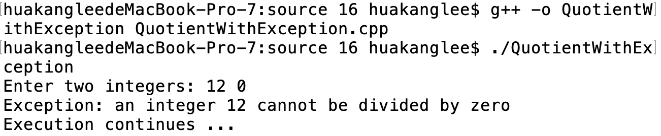
QuotientWithException.cpp
#include <iostream>
using namespace std;
int quotient(int number1, int number2)
{
if (number2 == 0)
throw number1;
return number1 / number2;
}
int main()
{
// Read two integers
cout << "Enter two integers: ";
int number1, number2;
cin >> number1 >> number2;
try
{
int result = quotient(number1, number2);
cout << number1 << " / " << number2 << " is "
<< result << endl;
}
catch (int ex)
{
cout << "Exception: an integer " << ex <<
" cannot be divided by zero" << endl;
}
cout << "Execution continues ..." << endl;
return 0;
}

Slide 14
Exception Classes

Slide 15
Using Standard Classes
These classes are used by some functions in the C++ standard library to throw exceptions.
You can also use these classes to throw exceptions in your programs. Listing 16.5 shows an example that handles the bad_alloc exception.

Slide 16
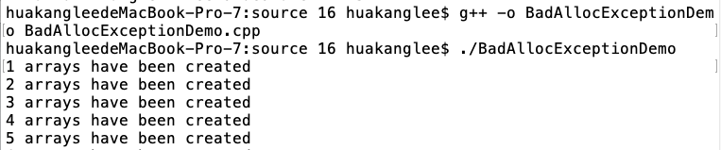

BadAllocExceptionDemo.cpp
#include <iostream>
using namespace std;
int main()
{
try
{
for (int i = 1; i <= 100; i++)
{
new int[70000000];
cout << i << " arrays have been created" << endl;
}
}
catch (bad_alloc& ex)
{
cout << "Exception: " << ex.what() << endl;
}
return 0;
}

Slide 17
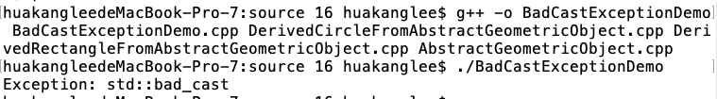
BadCastExceptionDemo.cpp
#include <typeinfo>
#include "DerivedCircleFromAbstractGeometricObject.h"
#include "DerivedRectangleFromAbstractGeometricObject.h"
#include <iostream>
using namespace std;
int main()
{
try
{
Rectangle r(3, 4);
Circle& c = dynamic_cast<Circle&>(r);
}
catch (bad_cast& ex)
{
cout << "Exception: " << ex.what() << endl;
}
return 0;
}

Slide 18
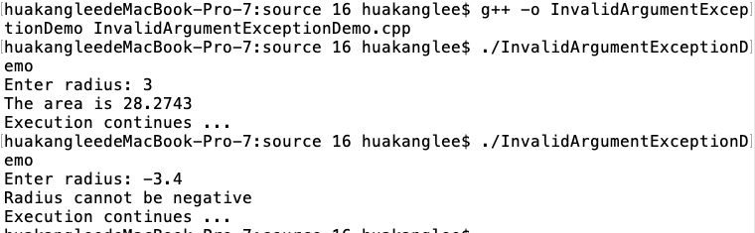
InvalidArgumentExceptionDemo.cpp
#include <iostream>
#include <stdexcept>
using namespace std;
double getArea(double radius)
{
if (radius < 0)
throw invalid_argument("Radius cannot be negative");
return radius * radius * 3.14159;
}
int main()
{
// Pormpt the user to enter radius
cout << "Enter radius: ";
double radius;
cin >> radius;
try
{
double result = getArea(radius);
cout << "The area is " << result << endl;
}
catch (exception& ex)
{
cout << ex.what() << endl;
}
cout << "Execution continues ..." << endl;
return 0;
}

Slide 19
Custom Exception Classes
C++ provides quite a few exception classes. Use them whenever possible instead of defining your own exception classes.
However, if you run into a problem that cannot be adequately described by the predefined exception classes, you can create your own exception class.
This class is just like any C++ class, but often it is desirable to derive it from exception or a derived class of exception so you can utilize the common operations (e.g., the what() function) in the exception class.

Slide 20
The Triangle Class

Slide 21
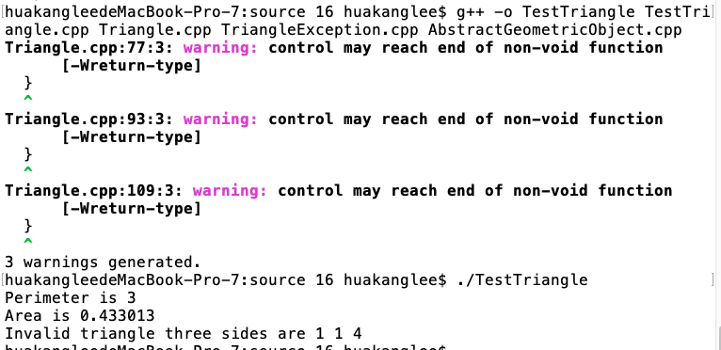
TestTriangle.cpp
#include <iostream>
#include "Triangle.h"
using namespace std;
int main()
{
try
{
Triangle triangle;
cout << "Perimeter is " << triangle.getPerimeter() << endl;
cout << "Area is " << triangle.getArea() << endl;
triangle.setSide3(4);
cout << "Perimeter is " << triangle.getPerimeter() << endl;
cout << "Area is " << triangle.getArea() << endl;
}
catch (TriangleException& ex)
{
cout << ex.what();
cout << " three sides are " << ex.getSide1() << " "
<< ex.getSide2() << " " << ex.getSide3() << endl;
}
return 0;
}

Slide 22
Multiple Catches
Most of time, a try block should run without exceptions. But occasionally, it may throw an exception. The exception can be of differing types.
For example, you may consider a non-positive value for a side in a triangle in the preceding example in Listing 16.10 is another type of exception different from a TriangleException.
So, the try block may throw a non-positve side exception or a TriangleException depending on the occasion. One catch block can catch only one type of exception.
C++ allows you to add multiple catch blocks after a try block in order to catch multiple types of exceptions.

Slide 23
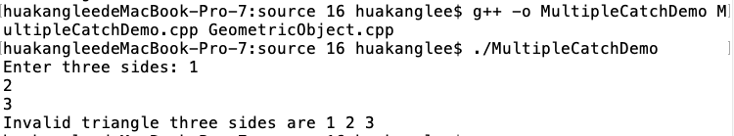
MultipleCatchDemo.cpp
#include <iostream>
#include "NewTriangle.h"
using namespace std;
int main()
{
try
{
cout << "Enter three sides: ";
double side1, side2, side3;
cin >> side1 >> side2 >> side3;
Triangle triangle(side1, side2, side3);
cout << "Perimeter is " << triangle.getPerimeter() << endl;
cout << "Area is " << triangle.getArea() << endl;
}
catch (NonPositiveSideException& ex)
{
cout << ex.what();
cout << " the side is " << ex.getSide() << endl;
}
catch (TriangleException& ex)
{
cout << ex.what();
cout << " three sides are " << ex.getSide1() << " "
<< ex.getSide2() << " " << ex.getSide3() << endl;
}
return 0;
}

Slide 24
catch block
Various exception classes can be derived from a common base class.
If a catch block catches exception objects of a base class, it can catch all the exception objects of the derived classes of that base class.

Slide 25
order of exception handlers
The order in which exceptions are specified in catch blocks is important. A catch block for a base class type should appear after a catch block for a derived class type.
Otherwise, the exception of a derived class is always caught by the catch block for the base class.
For example, the ordering in (a) is erroneous, because TriangleException is a derived class of logic_error. The correct ordering should be as shown in (b). In (a), a TriangleException occurred in the try block is caught by the catch block for logic_error.

Slide 26
Exception Propagation
You now know how to declare an exception and how to throw an exception.
When an exception is thrown, it can be caught and handled in a try-catch block, as follows:

Slide 27
Rethrowing Exceptions
C++ allows an exception handler to rethrow the exception if the handler cannot process the exception or the handler simply wants to let its caller be notified of the exception. The syntax may look like this:
try
{
statements;
}
catch (TheException &ex)
{
perform operations before exits;
throw;
}

Slide 28
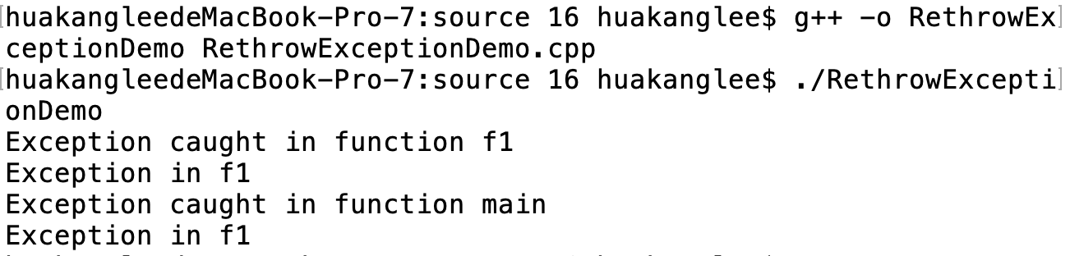
RethrowExceptionDemo.cpp
#include <iostream>
#include <stdexcept>
using namespace std;
int f1()
{
try
{
throw runtime_error("Exception in f1");
}
catch (exception& ex)
{
cout << "Exception caught in function f1" << endl;
cout << ex.what() << endl;
throw; // Rethrow the exception
}
}
int main()
{
try
{
f1();
}
catch (exception& ex)
{
cout << "Exception caught in function main" << endl;
cout << ex.what() << endl;
}
return 0;
}

Slide 29
Exception Specification
An exception specification, also known as throw list, lists exceptions that a function can throw.
So far, you have seen the function defined without a throw list. In this case, the function can throw any exception.
So, it is attempting to omit exception specification. However, this is not a good practice.
A function should warn the programmers that any exceptions it might throw, so the programmers can write robust program to deal with these potential exceptions in a try-catch block.
returnType functionName(parameterList) throw (exceptionList)

Slide 30
empty exception specification
Placing throw() after a function header, known as an empty exception specification, declares that the function does not throw any exceptions.
If a function attempts to throw an exception, a standard C++ function unexpected is invoked, which normally terminates the program.

Slide 31
undeclared exception
Throwing an exception that is not declared in the throw list will cause function unexpected to be invoked.
However, a function without exception specification can throw any exception and will not cause unexpected to be invoked.

Slide 32
When to Use Exceptions
In general, common exceptions that may occur in multiple classes in a project are candidates for exception classes.
Simple errors that may occur in individual functions are best handled locally without throwing exceptions.
Exception handling is for dealing with unexpected error conditions. Do not use a try-catch block to deal with simple, expected situations.
Which situations are exceptional and which are expected is sometimes difficult to decide. The point is not to abuse exception handling as a way to deal with a simple logic test.

Slide 33
General Paradigm for Exception
A general paradigm for exception handling is that you declare to throw an exception in a function as shown in (a), and use the function in a try-catch block as shown in (b).

Slide 34
summarization
Exception Overview
Throw-Catch
Exception Classes
Multiple Catches
Exception Specification

Slide 35



THANK YOU
Visit us
FOLLOW us
www.xjtlu.edu.cn
Notes:
Title: Uppercase, Calibri size 60, XJTLU Navy

